Slide 1
Welcome to SHARC
Simulator for use in SHARing and Compatibility studies of wireless communication systems

Slide 2
Introduction
Source code is be hosted in GitHub
Repository management
Task control
Tools to handle user stories (issues)
Repositories can be found in Simulator Working Group page
https://github.com/SIMULATOR-WG

Slide 3
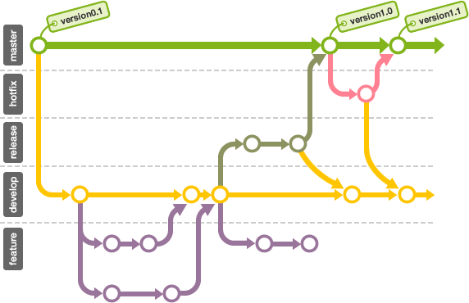
Repositories and branches
GitHub is hosting the source code and related documents
Learn more about Git and Git branching:
https://backlogtool.com/git-guide/en/
http://nvie.com/posts/a-successful-git-branching-model/

Slide 4
OOP vs Vectorization
This is a scalar!
bs = BaseStation()
for u in range(num_user_equipment):
ue = UserEquipment()
distance(u) = math.sqrt((bs.x-ue.x)**2 + (bs.y-ue.y)**2)
Class attributes are numpy arrays
This is a numpy array
bs = BaseStation()
ue = UserEquipmentManager()
distance = numpy.sqrt((bs.x-ue.x)**2 + (bs.y-ue.y)**2)

Slide 5
Unit tests framework
When you have to change software, how do you do it?
Edit and Pray
Cover and Modify
Developers are encouraged to use Test-Driven Development (TDD)
We use the second approach in this project!
What is a GOOD unit test? | What is NOT a good unit test?
It runs fast | It takes 1/10th of a second to run
It helps us finding problems | It talks to a database
Coverage | It communicates accross a network
 | It touches the file system

Slide 6
Unit tests framework
We use Python’s built-in support to write unit tests
import unittest
from antenna import Antenna
class AntennaTest(unittest.TestCase):
def setUp(self):
self.antenna = Antenna()
self.antenna.set_gain(5)
def test_gain(self):
self.assertEqual(5, self.antenna.get_gain())

Slide 7
Source code
Software follows the Model-View-Controller paradigm
View captures the user action and forwards it to Controller
Controller creates the simulation thread and starts it
View
Controller
SimulationThread
Model
Captures user action and forwards it to Controller
Creates the simulation thread and starts it
Initializes the model, perform simulation steps and finishes simulation
Contains a reference to the DownlinkManager, which actually implements the simulation method

Slide 8
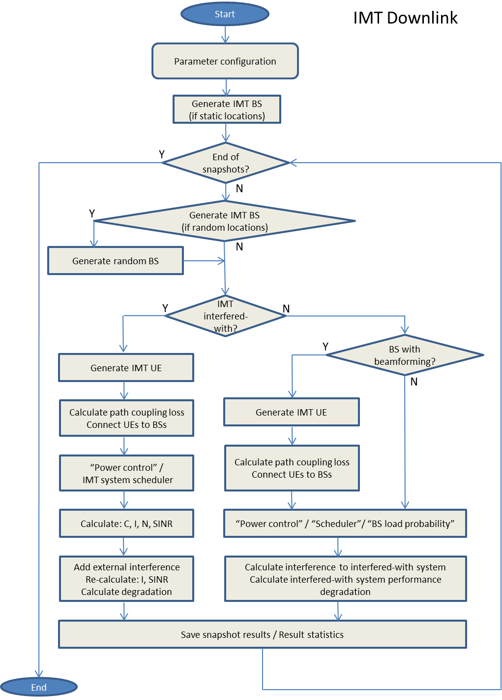
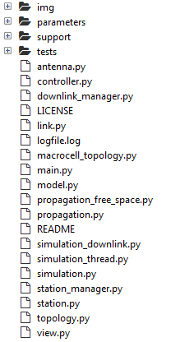
IMT downlink simulation method
classes to be created

Slide 9
Code style guide
This project adheres to:
PEP 8: Style Guide for Python Code
PEP 257: Docstring Conventions
Along with Style Guide, the following useful reading is suggested:
https://google.github.io/styleguide/pyguide.html
Example: naming
module_name, package_name, ClassName, method_name, ExceptionName, function_name, GLOBAL_CONSTANT_NAME, global_var_name, instance_var_name, function_parameter_name, local_var_name

Slide 10
Example on how to document source code
def __insert_text(self, source: str, text: str):
"""
This method can be called to display a message on the console. The same
message will be written to the log file and the file will also include
the name of the class that called the method. By default, all logging
messages will be written in INFO level.
Parameters
----------
source : Class name that called the method
text : Message that will be displayed on console and on log file
"""
self.__scrolledtext.insert(tkinter.INSERT, text + "\n")
self.__scrolledtext.see(tkinter.END)
logger = logging.getLogger(source)
logger.info(text)

Slide 11
Project-specific conventions
One class definition per file and encapsulated attributes
Place all your unit tests in tests/ directory
Power | dBm
Power spectral density | dBW/Hz
Frequency | MHz
Antenna gain | dBi
Attenuation (MCL, ACS, etc) | dB (positive)
Distance, height, etc | m
Angle | degree
Temperature | K

Slide 12


Project-specific conventions
Use Python 3.5 type hinting:
Read more about it:
https://blog.jetbrains.com/pycharm/2015/11/python-3-5-type-hinting-in-pycharm-5/
https://www.python.org/dev/peps/pep-0484/
def greeting(name):
return 'Hello, {}'.format(name)
def greeting(name: str) -> str:
return 'Hello, {}'.format(name)

Slide 13
Development environment
IDE: Anaconda with Python 3.5
TortoiseGit to manage local repositories

Slide 14
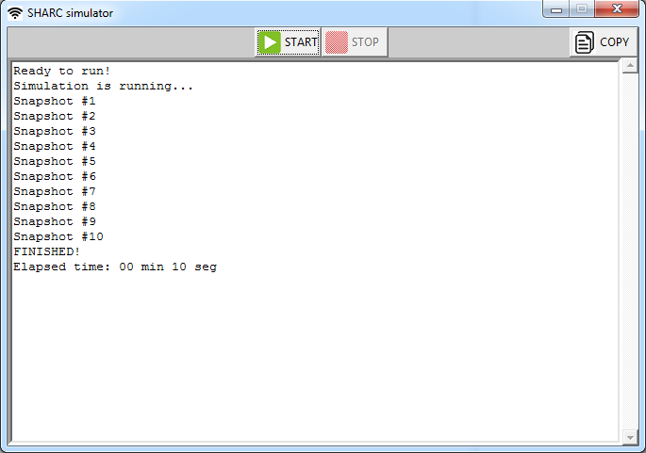
Branch status
Development branch contains a version that performs a fake simulation

Slide 15
Features to be implemented
Go to GitHub:
SIMULATOR-WG / SHARC / projects

